Slide 1
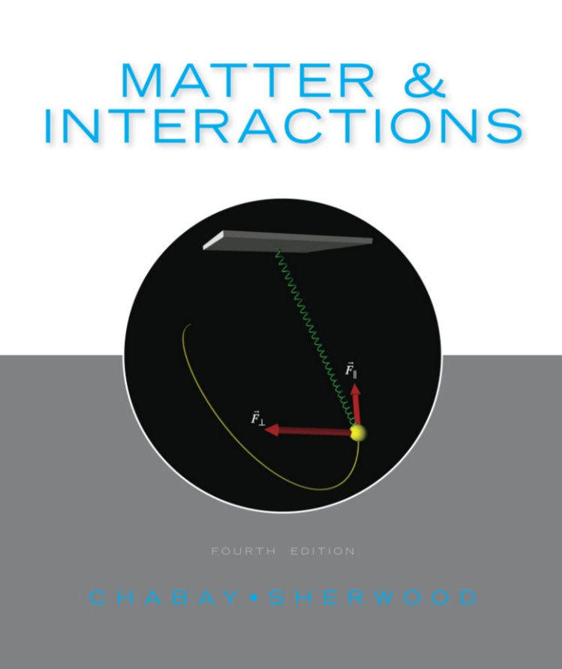


Electric Fields
General Physics II: Calculus-Based
PHYS 2331
Dr. Amy Roberts
Electric Charge and Force
Concept of the Electric Field
Electric Field of a Point Charge
Electric Field of a Dipole
Superposition and System Choice

Slide 2
Electric Fields
Content
Electric charge and force
Click through the slides to get an overview of electric fields.
OR
Click a topic on the right to jump to a
particular slide.
Concept of the electric field
Electric field of a point charge
Electric field of a dipole
Superposition and system choice

Slide 3


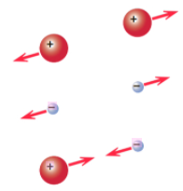
Electric Fields
Electric Charge and Force | Matter and Interactions | 13.2
Matter and Interactions (Fig 13.6, pg 516)
Point particle: an object with a radius that is small compared to the distance between it and other objects of interest (pg. 514).
There are two types of electric charge:
Positive
Negative
Protons (positive) and electrons (negative) are usually considered to be point particles.
Like charges repel
Unlike charges attract
Matter and Interactions (Fig 13.1, pg 514)

Slide 4
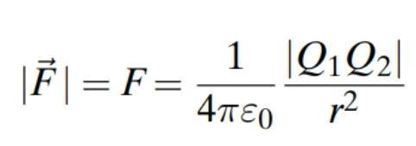
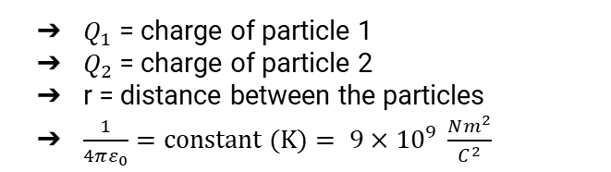
Electric Fields
Electric Charge and Force | Matter and Interactions | 13.2
Matter and Interactions (Fig 13.6, pg 516)
Coulomb’s Law: electric force law; describes magnitude of the electric force between two point particles (pg. 514).
Remember:
Electric force acts along a line between two point particles (pg 514)
Two charged objects interact - even if they are some distance apart! (pg 514)
$Q_{1}$ = charge of particle 1
$Q_{2}$ = charge of particle 2
r = distance between the particles
$\frac{1}{4πε_{0}}=constant (K)= 9×{10}^{9} \frac{Nm^{2}}{C^{2}}$

Slide 5
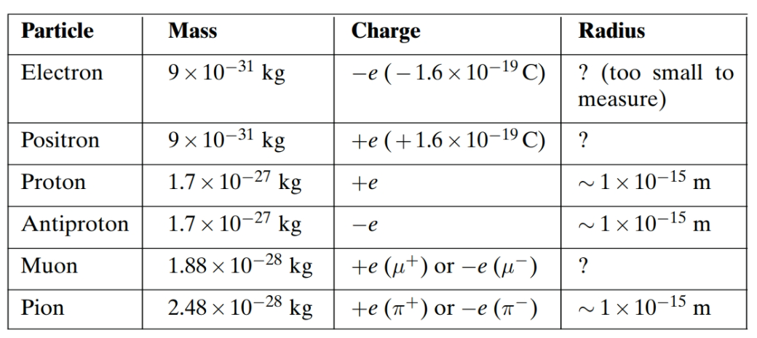
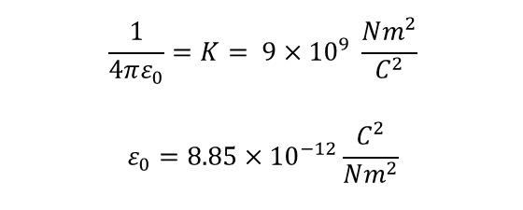
Electric Fields
Electric Charge and Force | Matter and Interactions | 13.2
Matter and Interactions (Fig 13.6, pg 516)
Units and Constants
See Physics II: Background Information for more information on SI units.
$$\frac{1}{4πε_{0}}=K= 9×{10}^{9} \frac{Nm^{2}}{C^{2}}$$
$$ε_{0}=8.85×{10}^{−12}\frac{C^{2}}{Nm^{2}}$$
Matter and Interactions (pg 514)

Slide 6

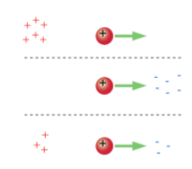
Electric Fields
Concept of the Electric Field | Matter and Interactions | 13.3
Matter and Interactions (pg 517)
This is a proton. How would an electron react in these situations?
Q: An electron has a smaller mass than a proton. Would the acceleration of an electron be >, <, or = to the acceleration of a proton?
↑
↓
Matter and Interactions (Fig 13.7, pg 516)
=

Slide 7
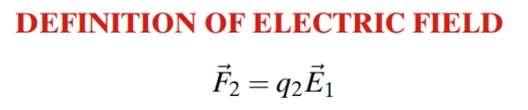
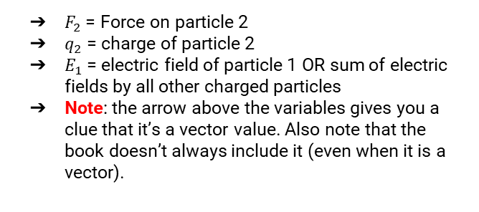
Electric Fields
Concept of the Electric Field | Matter and Interactions | 13.3
Matter and Interactions (pg 517)
The electric field from a point charge is always present.
A tree falls in a forest without anyone to hear it. Does it create a sound?
An electron exists without any particles by it. Is there still an electric field present?
An electric field will penetrate matter.
Units: N/C or V/m
$F_{2}$ = Force on particle 2
$q_{2}$ = charge of particle 2
$E_{1}$ = electric field of particle 1 OR sum of electric fields by all other charged particles
Note: the arrow above the variables gives you a clue that it’s a vector value. Also note that the book doesn’t always include it (even when it is a vector).

Slide 8
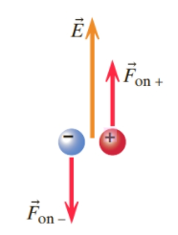
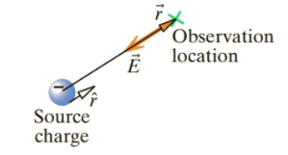
Electric Fields
Concept of the Electric Field | Matter and Interactions | 13.3
Matter and Interactions (pg 517)
Positive charge: Experiences force in direction of electric field
Negative charge: Experiences force in opposite direction of electric field
Note:
The electric field and forces are drawn using arrows (vectors).
Magnitude of the electric field
Matter and Interactions (Fig 13.12, pg 517)
Matter and Interactions (Fig 13.16 pg 519)

Slide 9
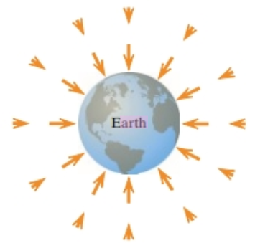
Electric Fields
Concept of the Electric Field | Matter and Interactions | 13.3
Matter and Interactions (pg 517)
No self-force: A point charge is not affected by its own electric field (pg. 518).
Field: physical quantity that has a value at every location in space (pg. 518).
An electric field is a vector field - there is a magnitude and direction at every location in space (pg. 518).
Mass of Earth creates a gravitational field (pg. 518)
Farther away from the surface of the Earth, gravitational field is smaller in magnitude (pg. 518)
This is similar to an electric field of a point charge!
Matter and Interactions (Fig 13.13, pg 518)

Slide 10

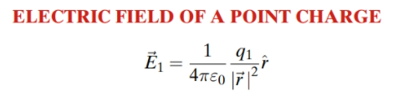
Electric Fields
Electric Field of a Point Charge | Matter and Interactions | 13.4
Matter and Interactions (pg. 519)
The electric field at the observation location = the electric field of a point charge
q1 = source charge
r_vec = position of the observation location relative to source charge
r_hat = unit vector in direction of r_vec
1/4\pi\epsilon_0 = constant (K) = 9*10**9 Nm^2/C^2

Slide 11
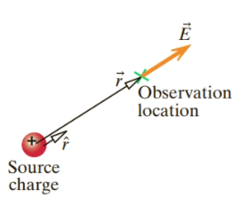
Electric Fields
Electric Field of a Point Charge | Matter and Interactions | 13.4
Matter and Interactions (pg. 519)
Direction of electric field at observation location depends on:
Direction of r_hat
Sign of the source charge (q1)
This can be positive or negative
q1 = positive:
q1r is in direction of r_hat (away from source charge)
q1 = negative:
q1r is in direction of -r_hat (toward source charge)
Matter and Interactions (Fig 13.14, pg 519)
Matter and Interactions (Fig 13.16, pg 519)

Slide 12
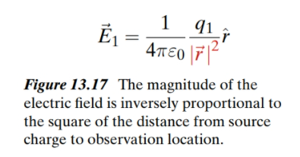
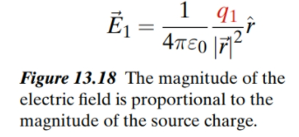
Electric Fields
Electric Field of a Point Charge | Matter and Interactions | 13.4
Matter and Interactions (pg. 519)
Electric field of a point charge depends on the distance between the source and observation locations:
Matter and Interactions (pg 519)
The larger the charge of the source particle, the larger the magnitude of the electric field:
Matter and Interactions (pg 520)

Slide 13

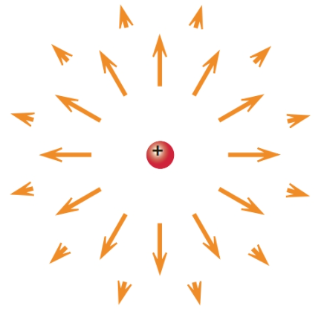

Electric Fields
Electric Field of a Point Charge | Matter and Interactions | 13.4
Matter and Interactions (pg. 519)
Positive charge:
Electric field points radially outward
= scalar quantity but doesn’t always = magnitude of electric field
Magnitude of a vector = positive quantity
Need to take absolute value to get magnitude
Matter and Interactions (Fig 13.19, pg 520)
Negative charge:
Electric field points radially inward
The magnitude of the electric field decreases with distance from the charge (note the size of the vectors with increasing distance).
Matter and Interactions (Fig 13.20, pg 520)

Slide 14

Electric Fields
Electric Field of a Dipole | Matter and Interactions | 13.6
Matter and Interactions (Fig 13.29, pg. 519)

Slide 15
Electric Fields
Superposition and system choice

